Slide 1

Nick Kempe
Machine learning:
Predicting Football
Salaries and longevity

Slide 2
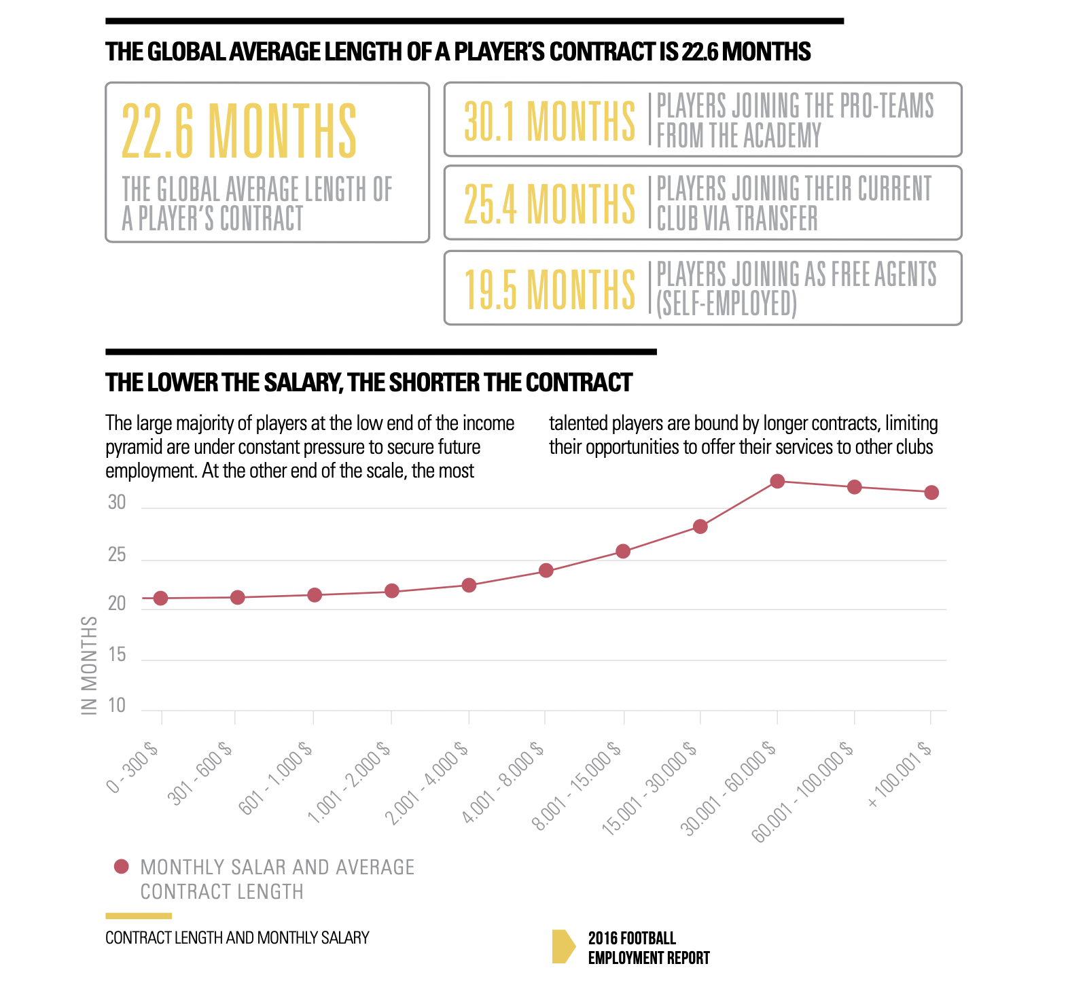
What's the goal? *Pun intended
2017/18 stats from Big 5:
Predict Player Salaries
Predict if Active in 5 years
Find untapped value
Mitigate big contract risk

Slide 3

DAta Sourcing and Issues

Slide 4

Methods

Slide 5
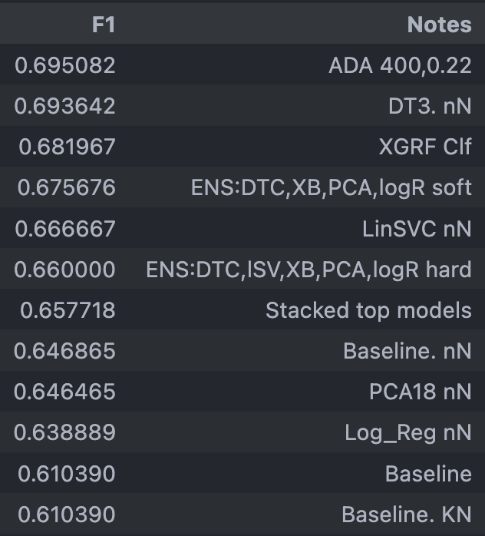
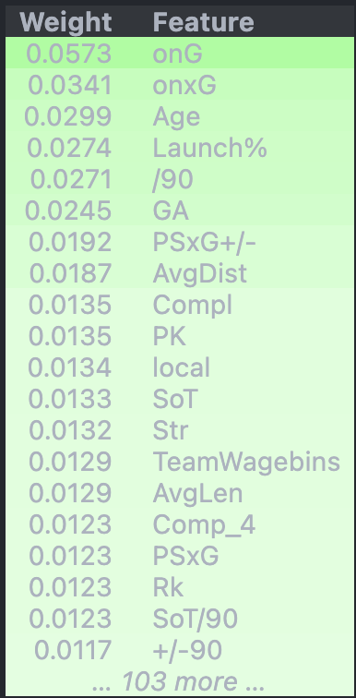


Classifier results
2:1 TARGET SPLIT
onxG -- Expected goals by team while on pitch
onxGA -- Expected goals allowed by team while on pitch

Slide 6
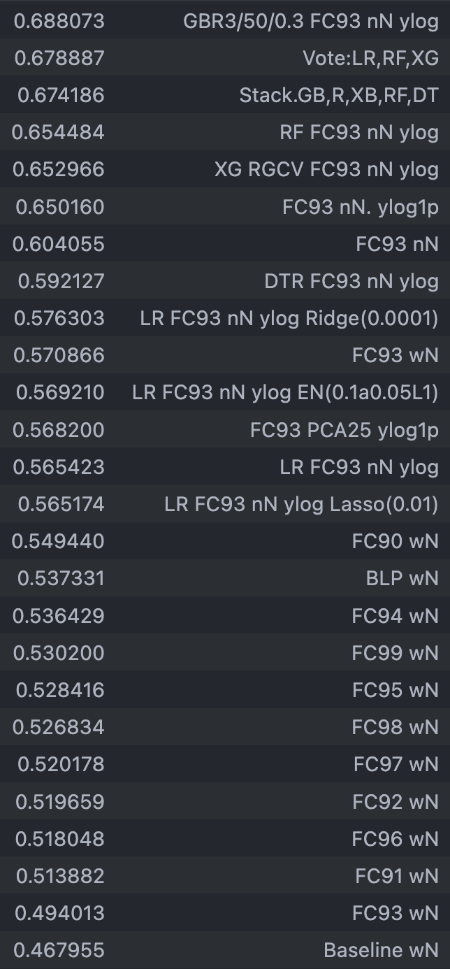
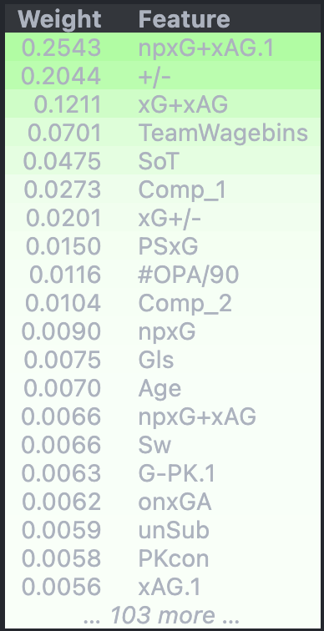
REGression results
npxG+xAG -- Non-Penalty Expected Goals plus Assisted Goals
+/- -- Plus/Minus
Goals scored minus goals allowed by the team while the player was on the pitch.

Slide 7
Main tools
XGBoost for baselines as it handles NaN values well.
KNN Imputer to compare with baseline including NaNs and dropping NaNs.
HalvingGridSearchCV from sklearn.experimental and RandomizedSearchCV, because life is too short to rely on GridSearchCV
The greatest gains achieved on both models came from Feature Engineering and Scaling rather than Hyperparameter Tuning.

